Slide 1


LESSON 3
TRIGONOMETRIC FUNCTIONS OF ANGLES

Slide 2




COORDINATE PLANE
The coordinate axes divide the plane into four parts called quadrants. For any given angle in standard position, the measurement boundaries for each quadrant are summarized as follows:
y
Quadrant II
Quadrant I
( -, + )
( +, + )
o
x
Quadrant III
Quadrant IV
( -, - )
( +, - )
Notes:
Week 3 rbteodoro_06@yahoo.com

Slide 3
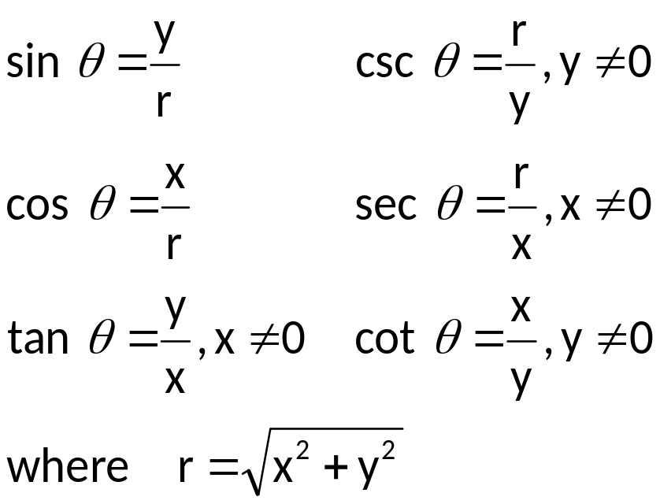

Definitions of the Trigonometric Functions of Any Angle
Let P(x, y) be any point, except the origin, on the terminal side of an angle θ in standard position. Let r = d(O, P), the distance from the origin to P. The six trigonometric functions of θ are
y
P(x, y)
r
y
x
x
O

Slide 4
SIGN OF TRIGONOMETRIC FUNCTIONS
The sign of a trigonometric depends on the quadrant in which the terminal side of the angle lies.
y
Sine and cosecant positive
All functions positive
x
Tangent and cotangent positive
Cosine and secant positive

Slide 5
Table 1: Sign of the Trigonometric Functions
Sign of | I | II | III | IV
sin θ and csc θ | Positive | Positive | Negative | Negative
cos θ and sec θ | Positive | Negative | Negative | Positive
tan θ and cot θ | Positive | Negative | Positive | Negative

Slide 6

TRIGONOMETRIC FUNCTIONS OF QUADRANTAL ANGLES
A quadrantal angle is an angle whose terminal side coincides with the x- or y-axis. The value of a trigonometric function of a quadrantal angle can be found by choosing any point on the terminal side of the angle and then applying the definition of that trigonometric function.
y
P(0,y)
P(-x,0)
P(x,0)
o
x
P(0,-y)

Slide 7
Table 2: Values of Trigonometric Functions of Quadrantal Angles
θ | sin θ | cos θ | tan θ | csc θ | sec θ | cot θ
0⁰ | 0 | 1 | 0 | undefined | 1 | undefined
90⁰ | 1 | 0 | undefined | 1 | undefined | 0
180⁰ | 0 | – 1 | 0 | undefined | – 1 | undefined
270⁰ | – 1 | 0 | undefined | – 1 | undefined | 0

Slide 8
REFERENCE ANGLE
Definition of a Reference
Given a nonquadrantal angle θ in standard position, its reference angle θ’ is the acute angle with positive measure formed by the terminal side of angle θ and the x – axis.
To find the reference angle θ’ in each quadrant,
Quadrant I: θ’ = θ
Quadrant II: θ’ = 180⁰ – θ
Quadrant III: θ’ = θ – 180⁰
Quadrant IV: θ’ = 360⁰ – θ

Slide 9
Reference Angle Evaluation Procedure
Let θ be a nonquadrantal angle in standard position with reference
angle θ’. To evaluate a trigonometric function of θ, use the following
procedure.
Determine the reference angle θ’.
Determine the sign of the trigonometric function of θ.
The value of the trigonometric function of θ equals the value of the trigonometric of θ’, prefixed with the correct sign.

Slide 10
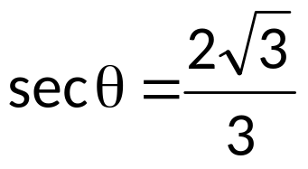
EXAMPLES
1. Find the value of each of the six trigonometric function for the angle, in standard position, whose terminal side passes through the given point.
a) P(–3, 4) b) P(–6, –9)
2. Let θ be in standard position, state the quadrant in which the terminal side of θ lies.
a) sin θ < 0, cos θ > 0
b) tan θ < 0, cos θ < 0
c) tan θ < 0, sin θ < 0
Find the exact value of each expression.
a) sin θ = –1/2, π < θ < 3π/2; find tan θ
b) cot θ = –1, 90⁰ < θ < 180⁰; find cos θ
c) , 3π/2 < θ < 2π; find sin θ

Slide 11
4. Find the measure of the reference angle θ’ for the given angle θ.
a) 52⁰ d) –6⁰
b) 351⁰ e) –475⁰
c) 1406⁰ f) 18π/7
Evaluate each function.
a) sin 225⁰ b) tan (5π/3)
6. Determine the exact value of the six trigonometric functions of the given angle θ in standard position.
a) 210⁰
b) 495⁰

Slide 12
7. Evaluate each expression, if possible.
a) sin (–270⁰) + cos 450⁰
b) csc 3600⁰ + sec (–3600⁰)
c) cos 540⁰ + tan 720⁰
d) tan² 225⁰ + sin 240⁰ cos 60⁰
e) sin² (5π/4) – cos² (5π/4) csc (5π/6)

